Slide 1
CONTINUING IOTA INTERNATIONAL OUTREACH:INDIA
PAUL D. MALEY
IOTA ANNUAL MEETING JULY 2017

Slide 2
EXPANDING IOTA
IOTA CANNOT REMAIN STAGNANT IN TERMS OF OVERALL MEMBERSHIP
OUTREACH IN PRIOR YEARS TO IRAN
2015 OBSERVATION OF DIONE ASTEROID OCCULTATION IN NEW DELHI ON OCTOBER 3
2016 NEW OPPORTUNITY ON DECEMBER 24 WITH KALLIOPE

Slide 3


Slide 4
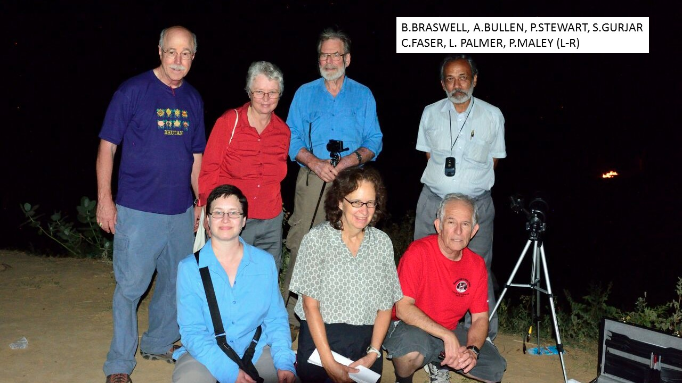

Slide 5
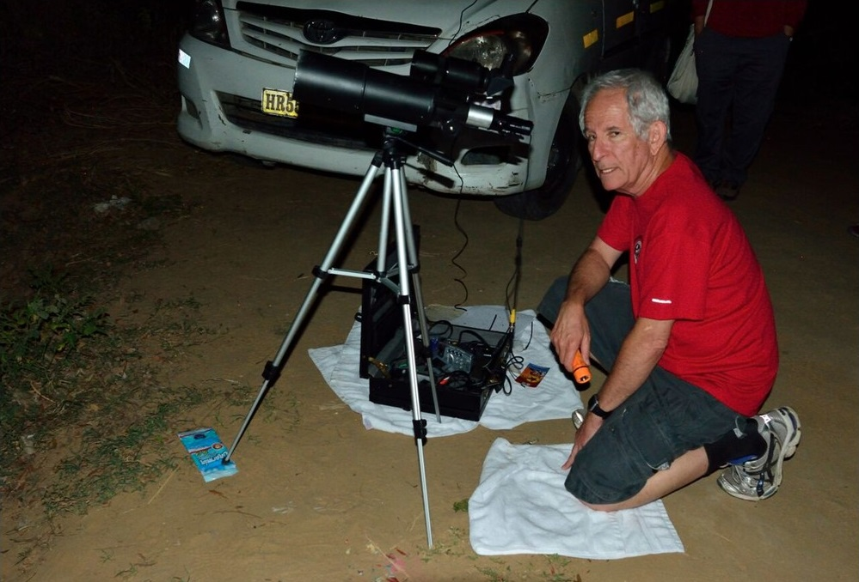

Slide 6
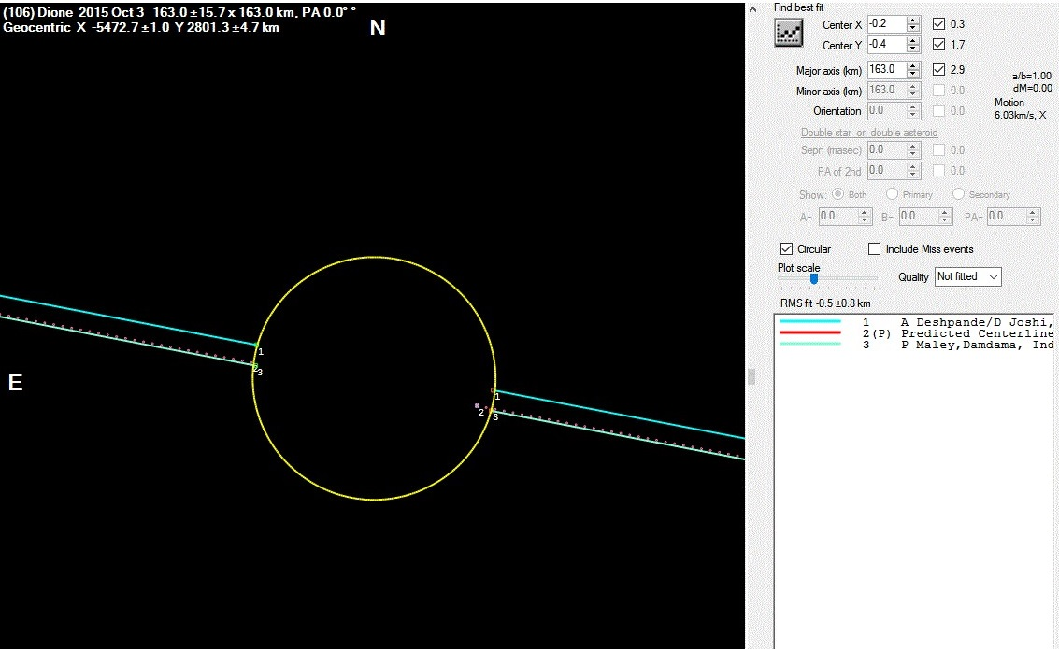

Slide 7
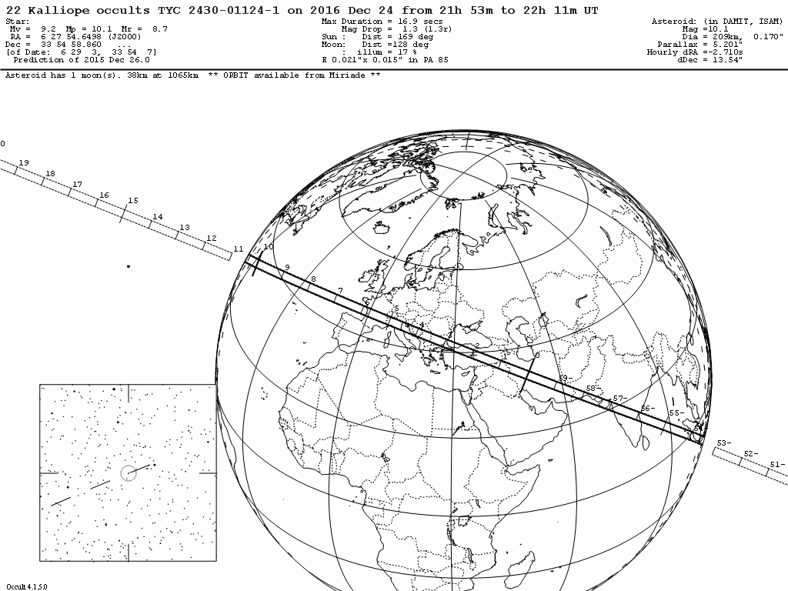

Slide 8
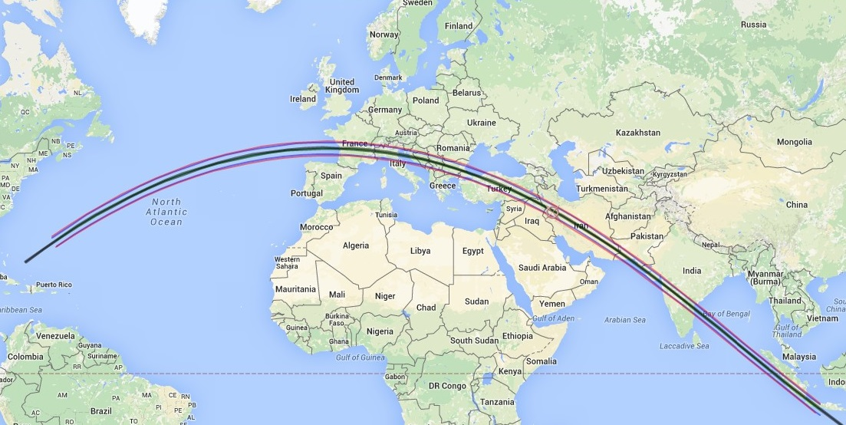
KALLIOPE TRACK

Slide 9
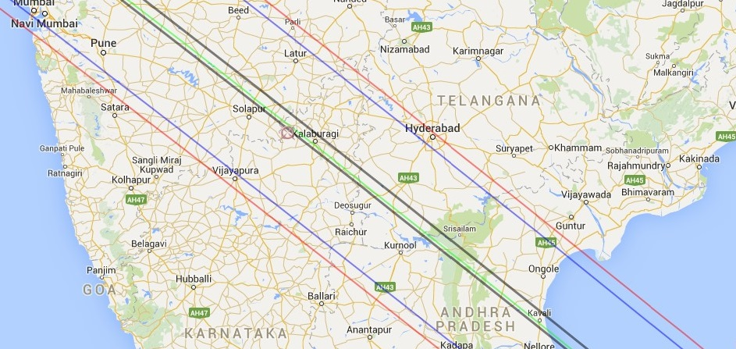
BASE

Slide 10
GOAL
TO ATTEMPT TO ENCOURAGE INDIAN OBSERVERS TO GO AFTER MINOR PLANET OCCULTATIONS INITIALLY
TO FORM AN IOTA/INDIA SECTION

